Slide 1
ABC Inc
William Chen, Sydney Fogelman, Spencer Pickett, Bingrui Su, Xinyue Ma

Slide 2
Summary of ABC challenges
Internal audit team is unable to identify key processes and risk areas that need to be automated
IT controls are manual and inconsistent
Different teams duplicating the same kind of financial reports
IBM OpenPages GRC (Governance, Risk Management, and Control) tool is too difficult to understand by auditors
Data quality identification is mostly manual and not standardized (formatting issues)
Data analytics is too confusing
Lack of stakeholder engagement
Notes:
Xinyue

Slide 3
Cyber/IT Risk Implementation Overview
Waterfall model
Origami Risk
NextAgency
Weekly meetings with client to measure progress
6 months for implementation and training
Notes:
Xinyue

Slide 4
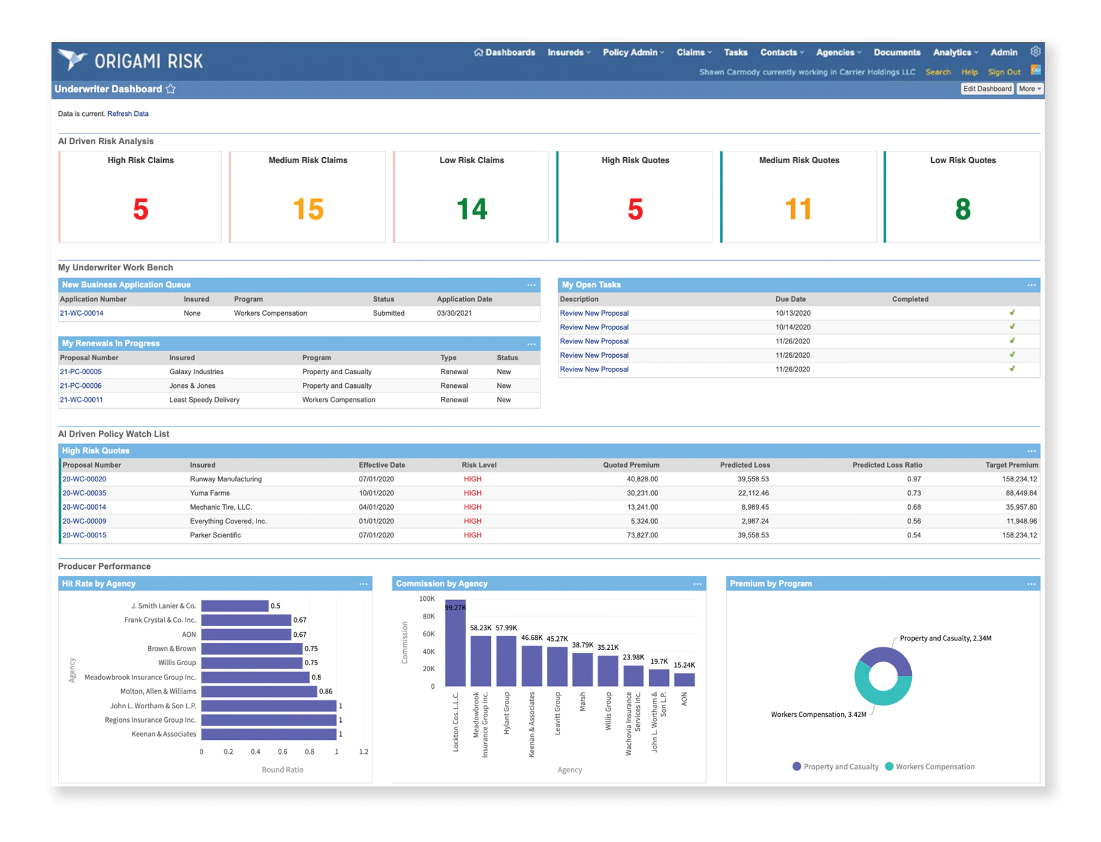
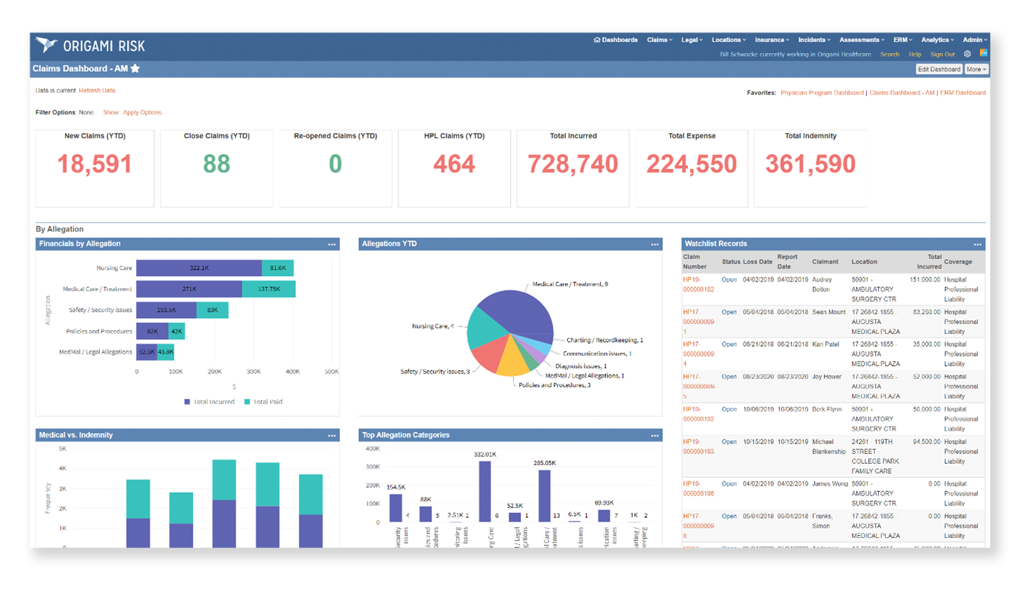
Origami Risk (part of software stack)
Origami Risk is an insurance risk management software
Can replace IBM OpenPages GRC
Dedicated to the risk and insurance industry
Has a GRC suite that provides real-time dashboards, automatic reports, task management, risk management, and automated risk notifications

Slide 5
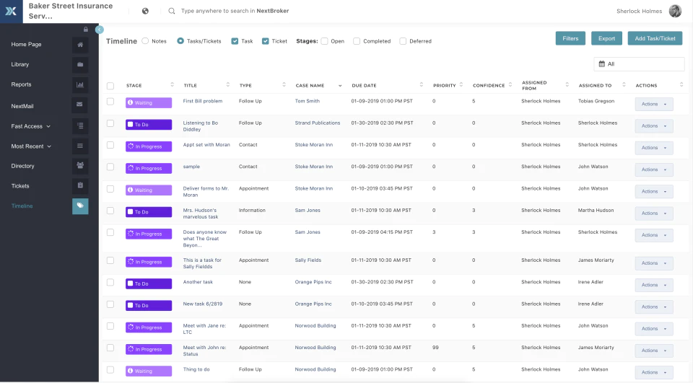
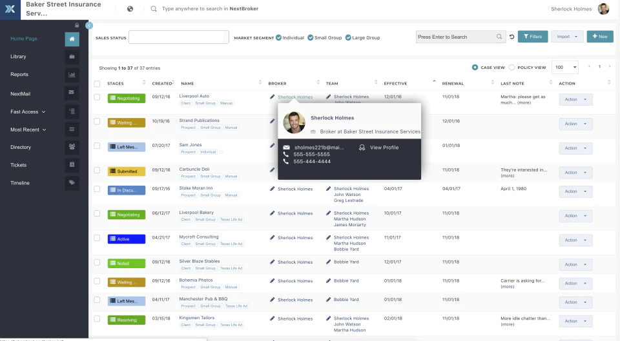
NextAgency (part of software stack)
NextAgency is a management system with CRM (customer relationship manager), marketing, and commission management tool
Automatically create and analyze reports
Automate tasks and keep in touch with customers
Track finances/commissions (auditing and analysis)

Slide 6
Cyber/IT Risk Implementation
Requirements
Design
Implementation
Control
Closure
Waterfall Model
Notes:
sydney
Requirements : Analyzed data, identified weakest ports, identified procedural issues
Design: Automating processes, advising on an onsite-offshore hybrid model, installing a new software stack, create a risk management team
Implementation: Put into motion all the designs and have weekly meetings tracking progress and measuring progress
Control: Track progress to our plans and reach out to stakeholders to measure their satisfaction
Closure: Get final approval and make sure their risk management team is in place

Slide 7
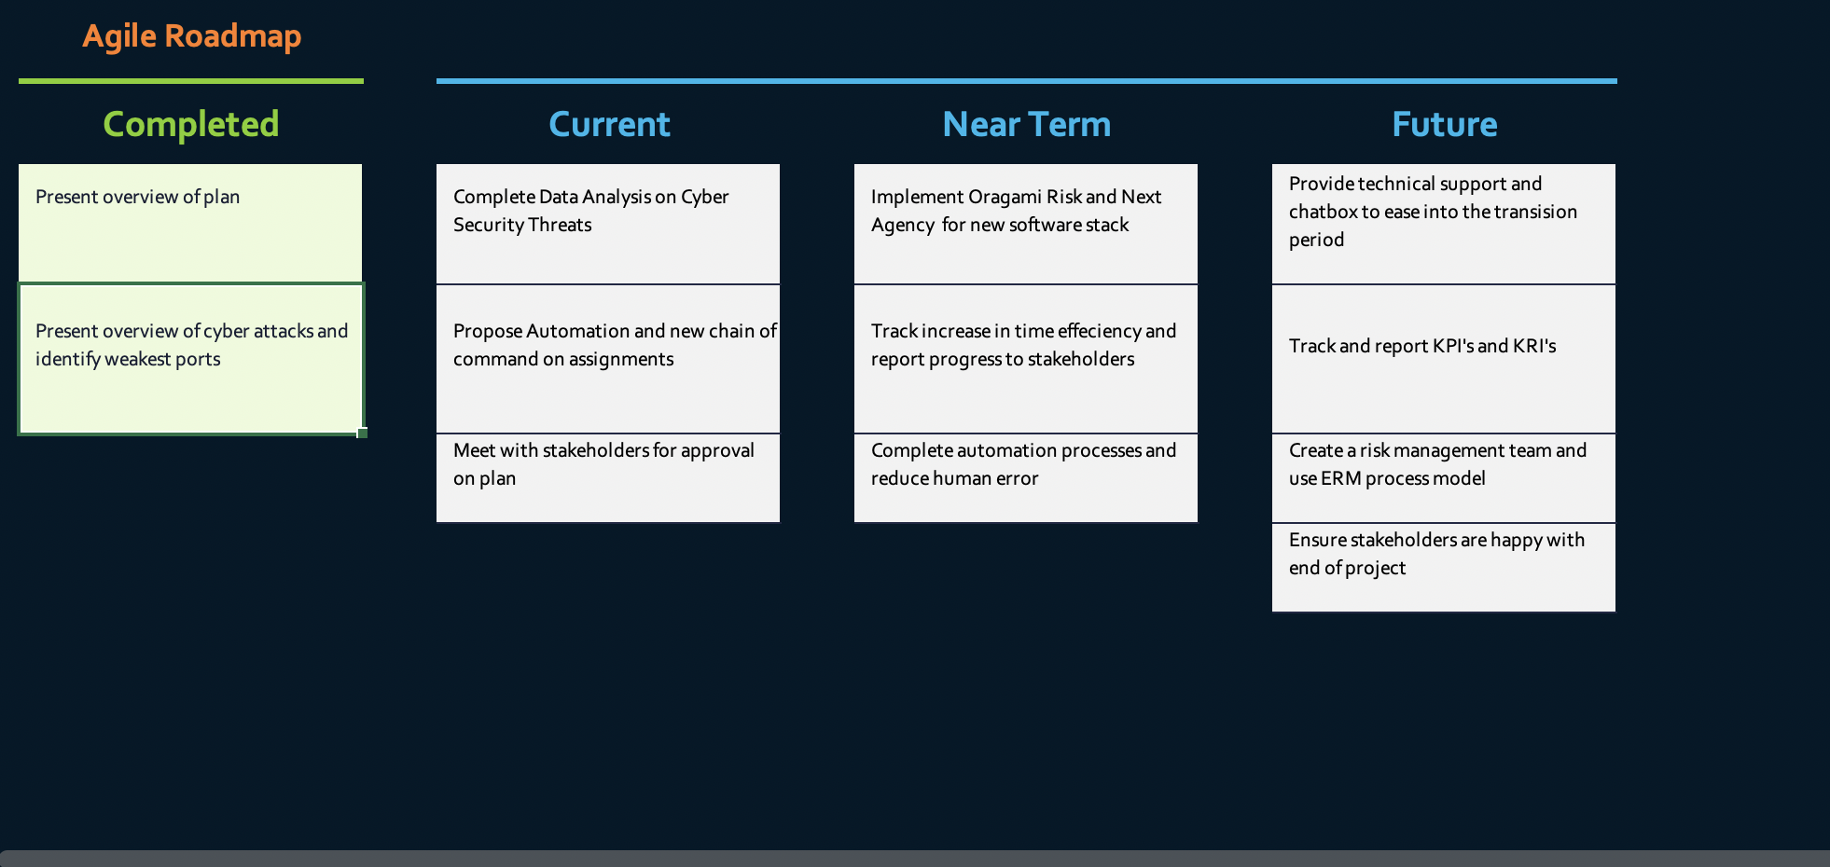

Slide 8
Financial Sector
Consultation
We will consult client stakeholders to learn how they want ABC Inc to interact with them
Consulting within the organization will be used to determine which processes can be improved
Inquire about things they want that board members didn’t mention
Technology Trends
Chatbots - seamlessly interact with customers (have a bot walk customers through applications and policies, reserving human interaction for more complex things)
Predictive analytics - collect data and predict customer behavior (can also be used for risks)
Notes:
Notes: 100 million customers and only 45 audit groups!

Slide 9
Financial Sector
Model of Delivery
Onsite-offshore hybrid model: costs can be reduced and resources can be maximized and used more efficiently
Onsite: Communication and final meeting/debrief
Offsite: Reduces cost for the project
Further Engagement
We will provide technical support along the way since we are only providing guidance and assistance for this time
With permission, follow up with employees to receive feedback on deliverables
Recommend changes

Slide 10
Data Quality and Governance
Dataset was provided as a json file
Use a json validator as the initial assessment
Use Python to report data
KPI’s (Key Performance Indicators) being tracked:
Revenue growth
Average resolution time
Employee satisfaction rating
Monthly website tracking
KRI’s (Key Risk Indicators) being tracked:
System availability - uptime/downtime
Percentage of unplanned downtime
Outages resulting from attacks
Average time to detect and resolve attacks

Slide 11
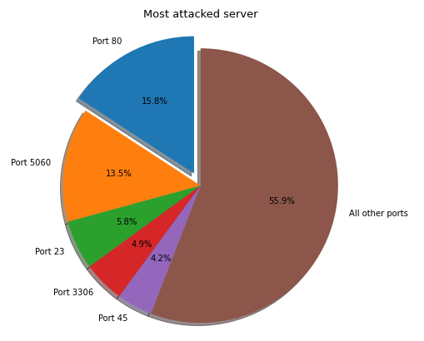
Which server was attacked the most?

Slide 12
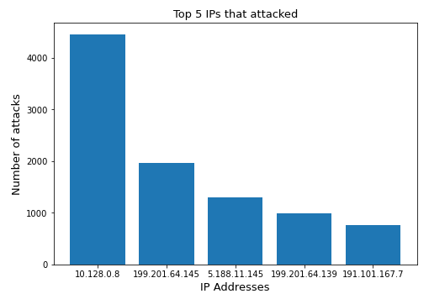
What are the top 5 IPs attacking ABC’s servers?

Slide 13
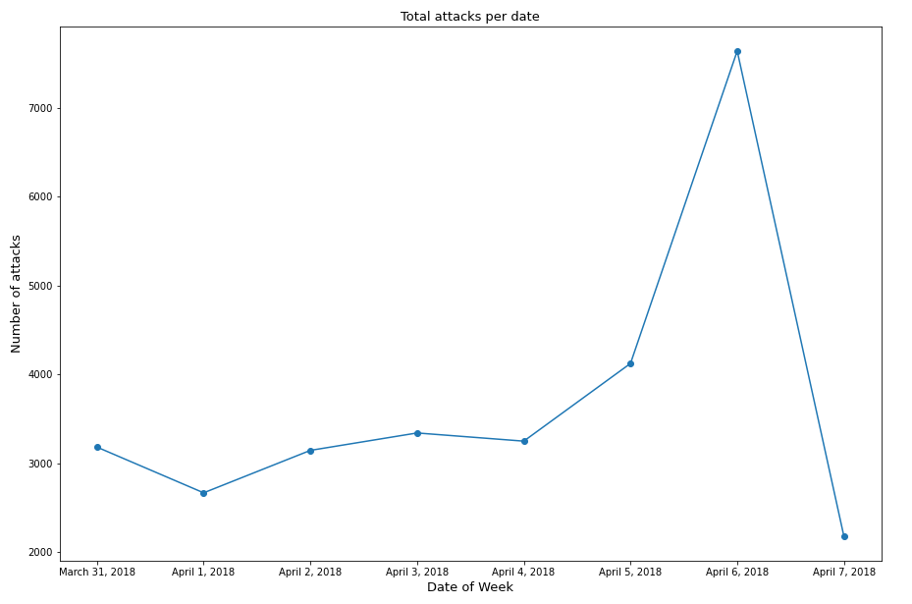
What day had the most number of attacks?

Slide 14
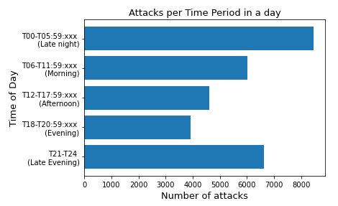
What time of day had most attacks?

Slide 15
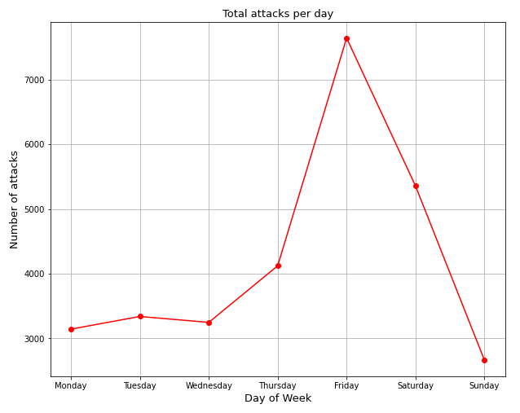
What day of the week had the most attacks?

Slide 16
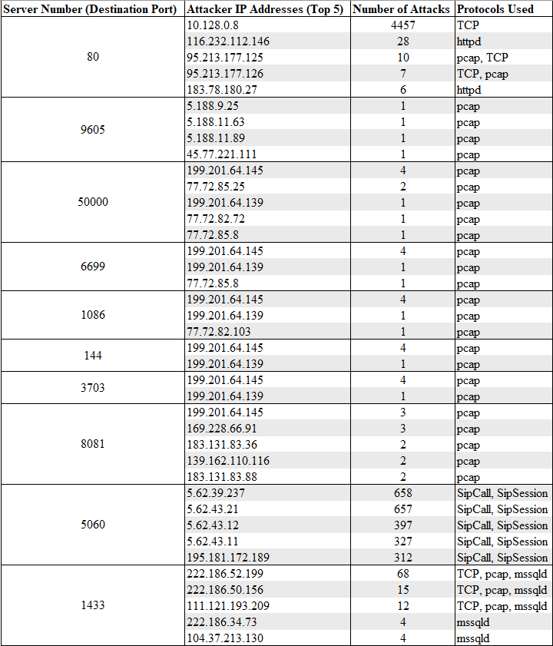
Top 5 attacker IPs per server

Slide 17
Summary of cyber attacks
Destination port 80 was attacked the most (4,660 times)
Most attacks came from 10.128.0.8. They attacked server 80, 4,457 times and used the TCP protocol
April 6, 2018 (Friday) had the most attacks (7,642 attacks)
Attacks tend to happen during the nighttime
Attacks are also more likely to occur during the weekends

Slide 18
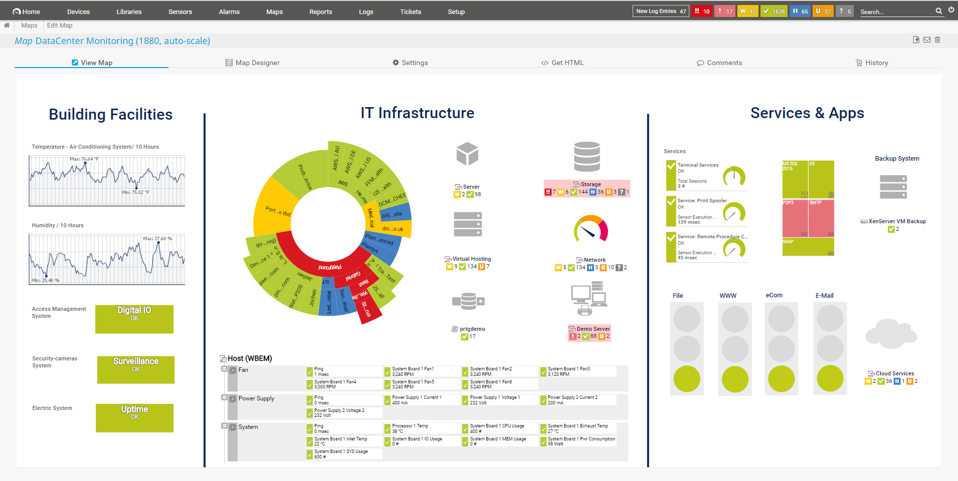
Recommendations
Configure a firewall - prevents TCP attacks
PRTG Network Monitor
Monitors and classifies infrastructure statistics
Supports IT standards
Real-time updates
Move to the cloud - mitigate attacks
Create a defense plan

Slide 19
Sources
https://wgntv.com/weather/how-do-you-define-daytime-and-evening-times-in-a-weather-forecast/
https://www.capterra.com/p/146388/Origami-Risk/
https://www.origamirisk.com/
https://nextagency.com/
https://www.capterra.com/p/171245/NextAgency/
https://hlassets.paessler.com/common/files/screenshots/prtg-v17-4/basics/map-data-center.png

